Slide 2
Overview
Part1 - Introduction
Design Topics
Design hierarchy
Design Procedure
The major design steps: specification, formulation, optimization, technology mapping, and verification
Technology Mapping
From AND, OR, and NOT to other gate types
Decoders
Part 2
Encoders
Multiplexers
Binary Adders

Slide 3
Encoding
Encoding - the opposite of decoding - the conversion of an m-bit input code to a n-bit output code with n ≤ m ≤ 2^{n} such that each valid code word produces a unique output code
Circuits that perform encoding are called encoders
An encoder has 2^{n} (or fewer) input lines and n output lines which generate the binary code corresponding to the input values
Typically, an encoder converts a code containing exactly one bit that is 1 to a binary code corres-ponding to the position in which the 1 appears.

Slide 4
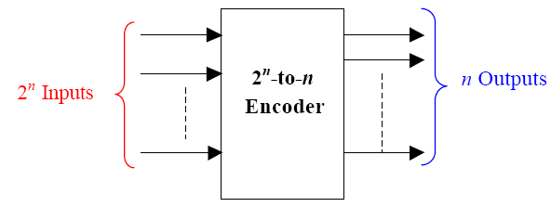
Encoder

Slide 5
Encoder Example
A decimal-to-BCD encoder
Inputs: 10 bits corresponding to decimal digits 0 through 9, (D₀, …, D₉)
Outputs: 4 bits with BCD codes
Function: If input bit D_{i} is a 1, then the output (A₃, A₂, A₁, A₀) is the BCD code for i,
The truth table could be formed, but alternatively, the equations for each of the four outputs can be obtained directly.

Slide 6
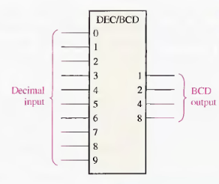
Decimal-to-BCD encoder

Slide 7
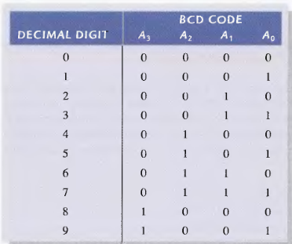
Encoder Example (continued)
Input D_{i} is a term in equation A_{j} if bit A_{j} is 1 in the binary value for i.
Equations:
A₃ = D₈ + D₉
A₂ = D₄ + D₅ + D₆ + D₇
A₁ = D₂ + D₃ + D₆ + D₇
A₀ = D₁ + D₃ + D₅ + D₇ + D₉
F₁ = D₆ + D₇ can be extracted from A₂ and A₁ Is there any cost saving?
Notes:
No. The total gate input cost remains the same.

Slide 8
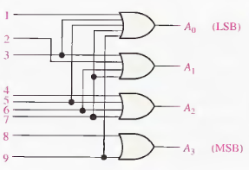
Encoder Example (continued)
A₃ = D₈ + D₉
A₂ = D₄ + D₅ + D₆ + D₇
A₁ = D₂ + D₃ + D₆ + D₇
A₀ = D₁ + D₃ + D₅ + D₇ + D₉

Slide 9
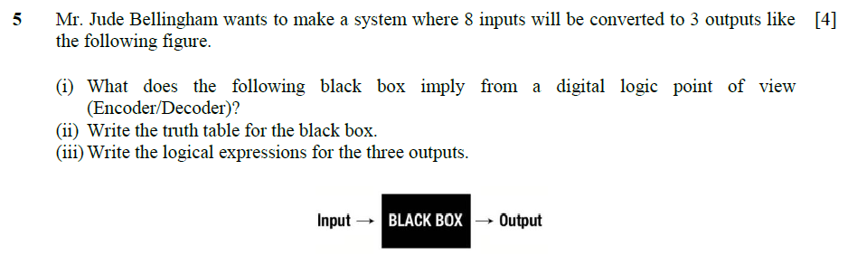
Spring 2024 Question 5

Slide 10
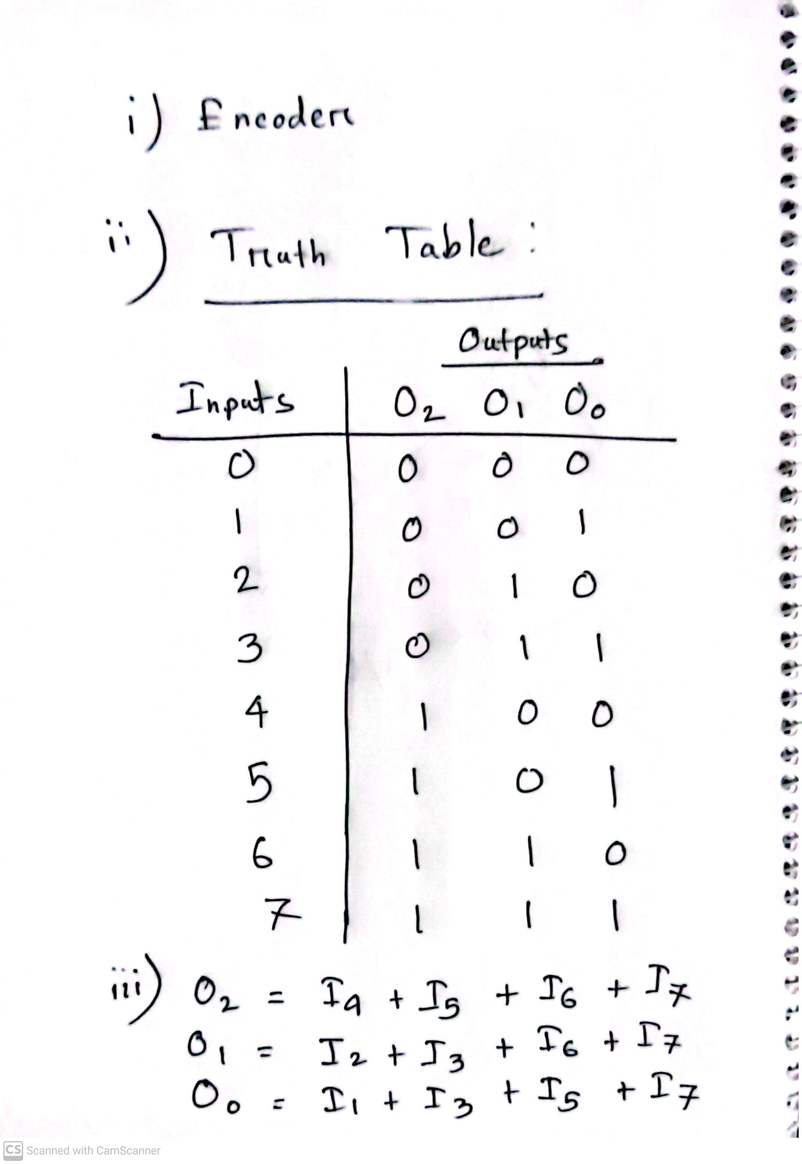
Spring 2024 Question 5

Slide 11
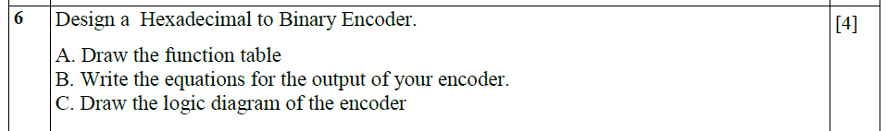
Fall 2023 Question 6

Slide 12
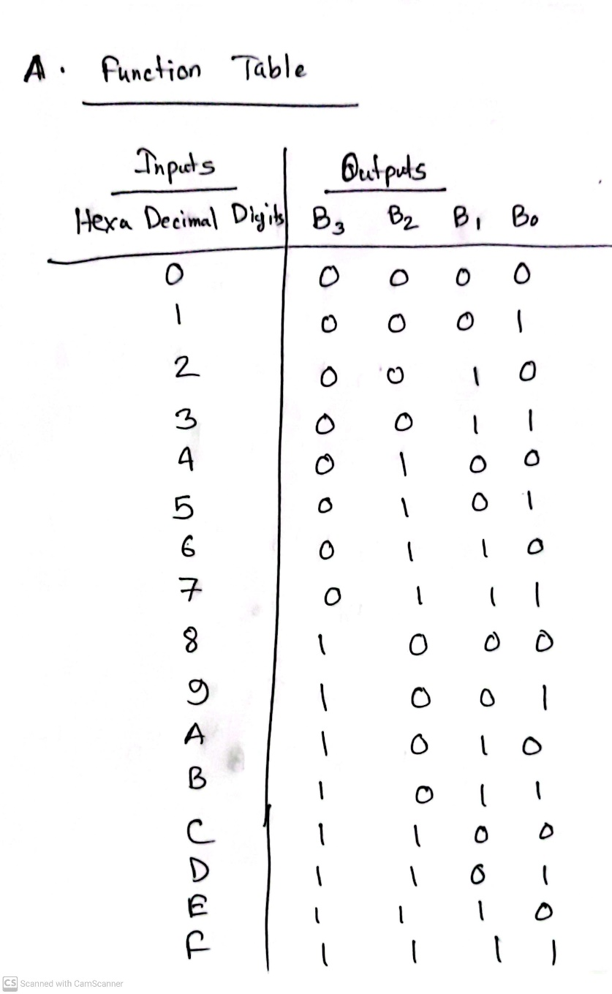
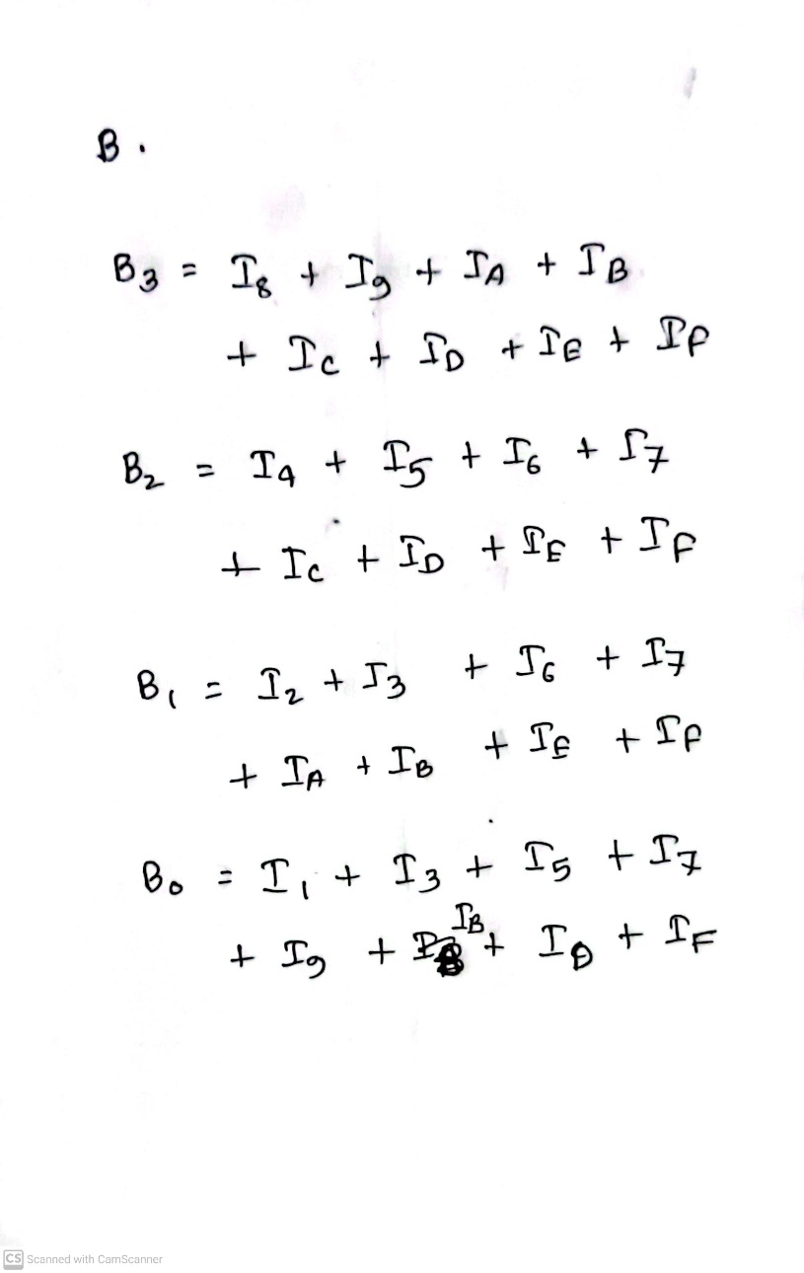
Fall 2023 Question 6

Slide 13
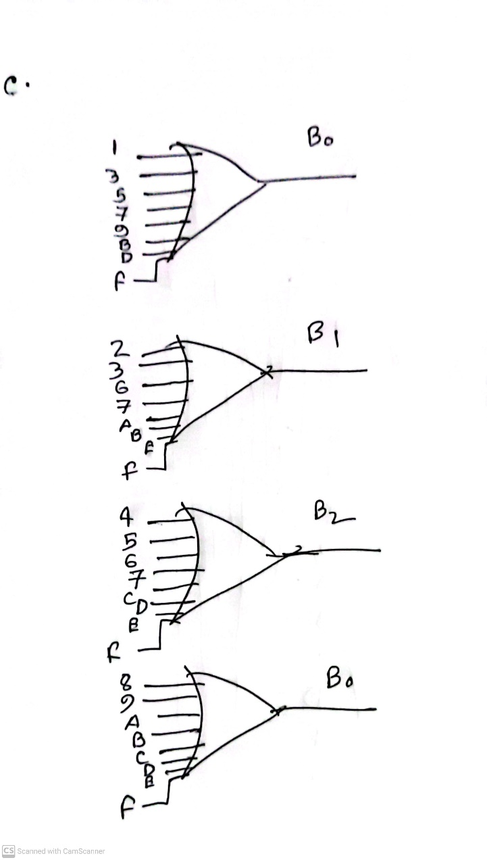
Fall 2023 Question 6

Slide 14
Priority Encoder
If more than one input value is 1, then the encoder just designed does not work.
One encoder that can accept all possible combinations of input values and produce a meaningful result is a priority encoder.
Among the 1s that appear, it selects the most significant input position (or the least significant input position) containing a 1 and responds with the corresponding binary code for that position.

Slide 15
Priority Encoder Example
Priority encoder with 5 inputs (D₄, D₃, D₂, D₁, D₀) - highest priority to most significant 1 present - Code outputs A2, A1, A0 and V where V indicates at least one 1 present.
Xs in input part of table represent 0 or 1; thus table entries correspond to product terms instead of minterms. The column on the left shows that all 32 minterms are present in the product terms in the table
No. of Min-terms/Row | Inputs |  |  |  |  | Outputs
 | D4 | D3 | D2 | D1 | D0 | A2 | A1 | A0 | V
1 | 0 | 0 | 0 | 0 | 0 | X | X | X | 0
1 | 0 | 0 | 0 | 0 | 1 | 0 | 0 | 0 | 1
2 | 0 | 0 | 0 | 1 | X | 0 | 0 | 1 | 1
4 | 0 | 0 | 1 | X | X | 0 | 1 | 0 | 1
8 | 0 | 1 | X | X | X | 0 | 1 | 1 | 1
16 | 1 | X | X | X | X | 1 | 0 | 0 | 1
Notes:
Go over table explaining how entries were obtained, particularly those containing Xs

Slide 16
Priority Encoder Example (continued)
Could use a K-map to get equations, but can be read directly from table and manually optimized if careful:
A₂ = D₄
A₁ = D₃ + D₂ = F₁, F₁ = (D₃ + D₂)
A₀ = D₃ + D₁ = (D₃ + D₁)
V = D₄ + F₁ + D₁ + D₀
D₄
D₄
D₃
D₄
D₄
D₄
D₃
D₂
D₄
D₂

Slide 17
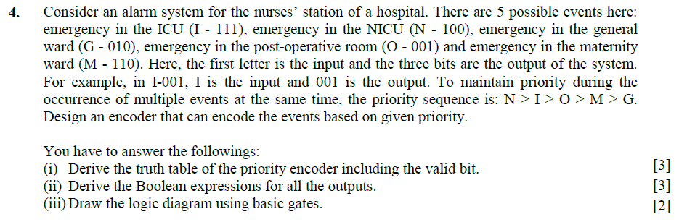
Spring 2024 Question 4

Slide 18
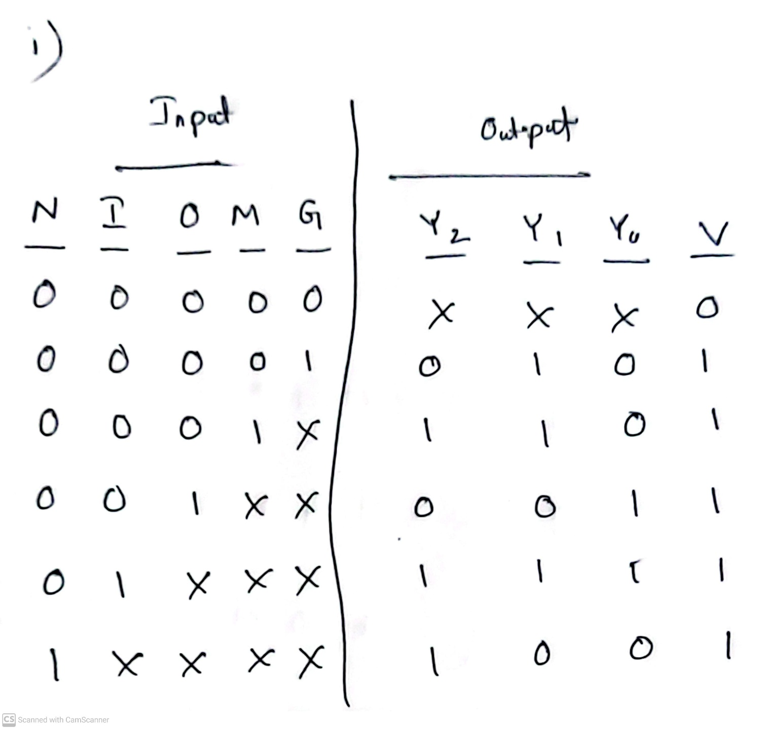
Spring 2024 Question 4

Slide 19
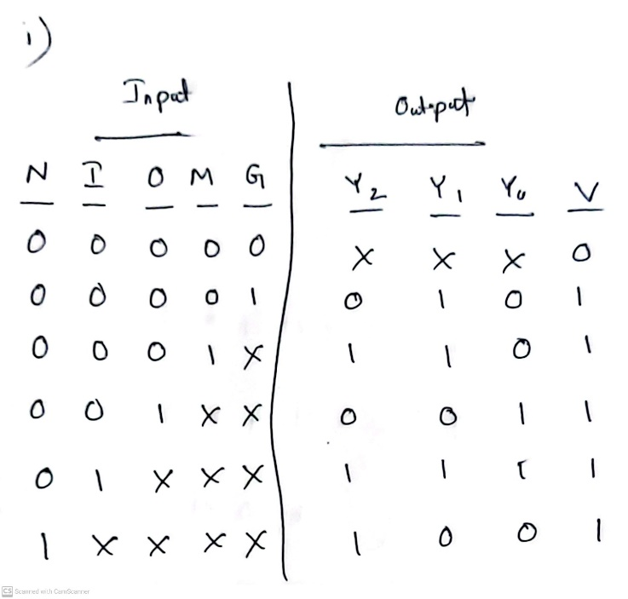
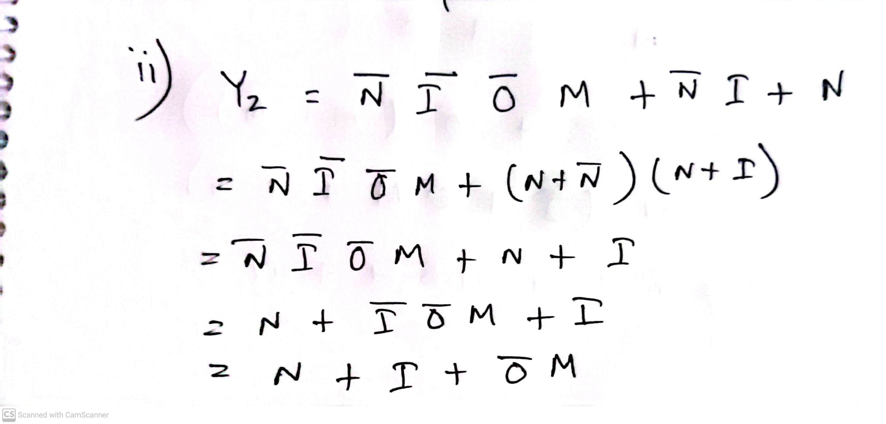
Spring 2024 Question 4

Slide 20
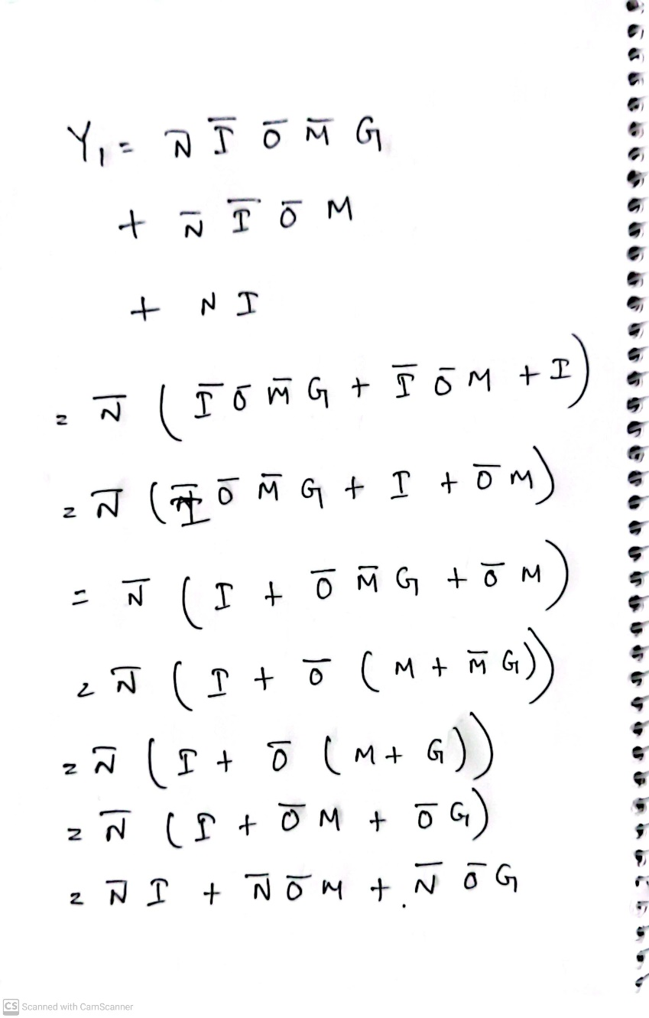
Spring 2024 Question 4

Slide 21
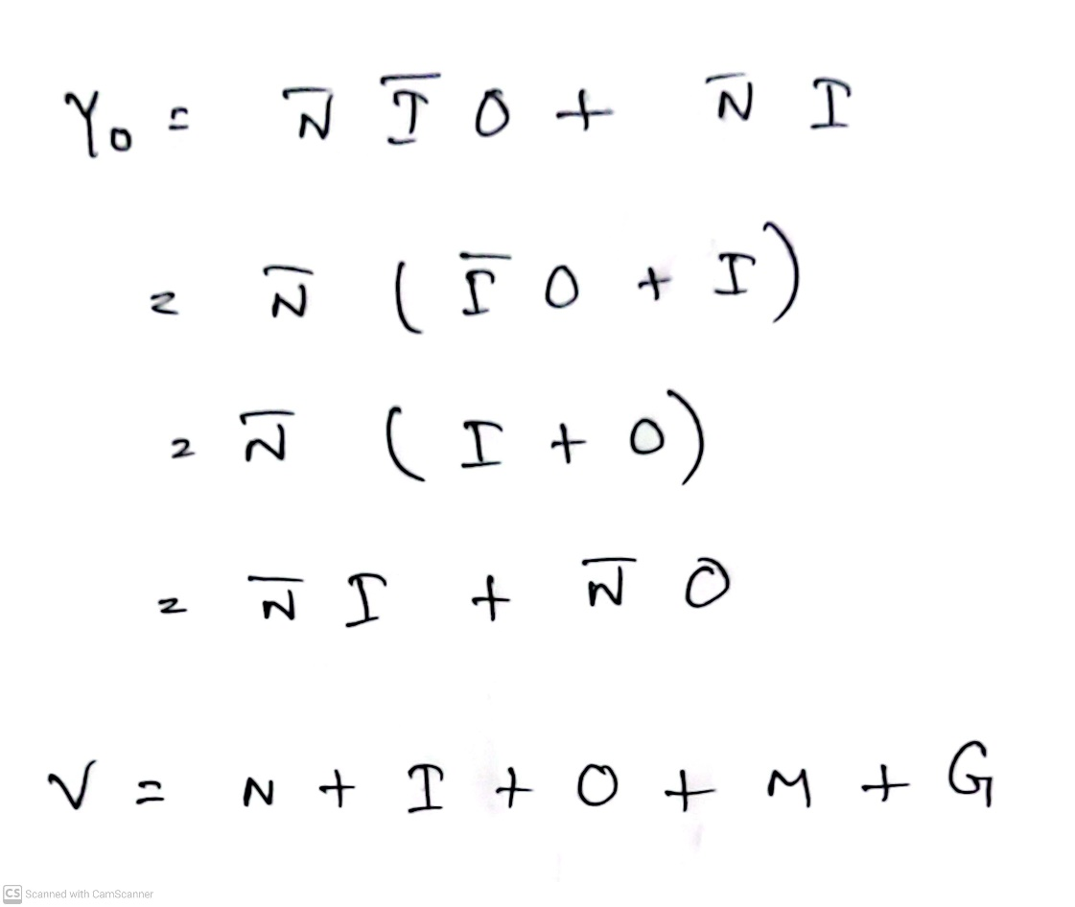
Spring 2024 Question 4

Slide 22
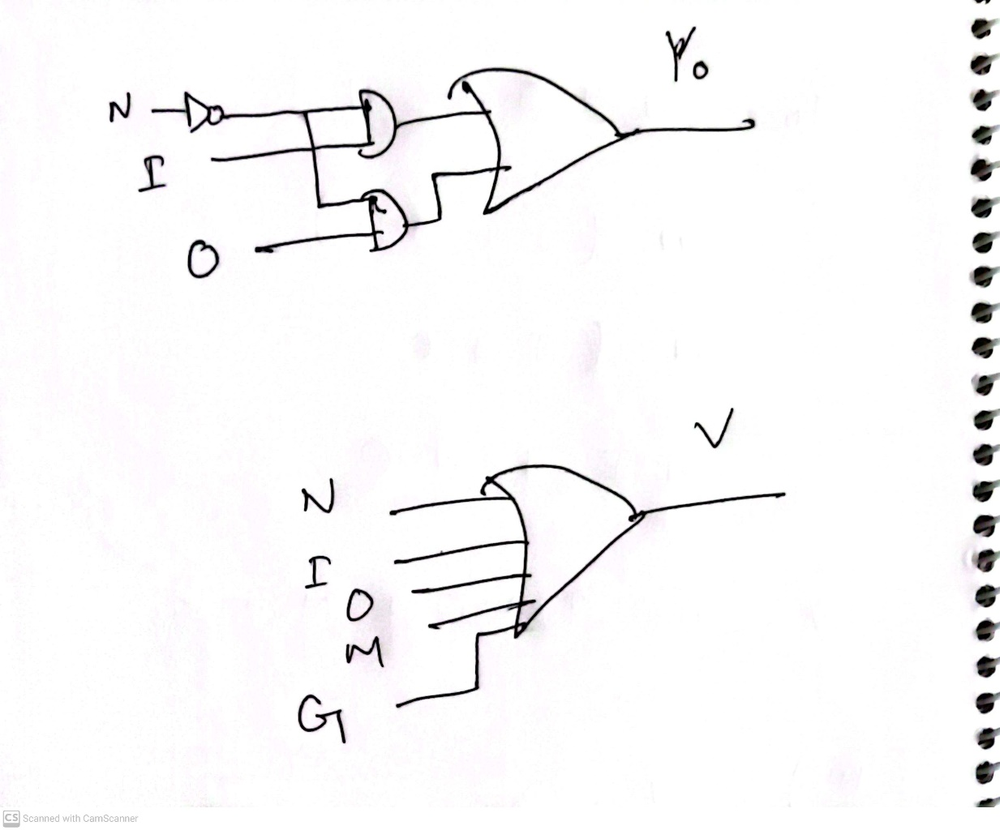
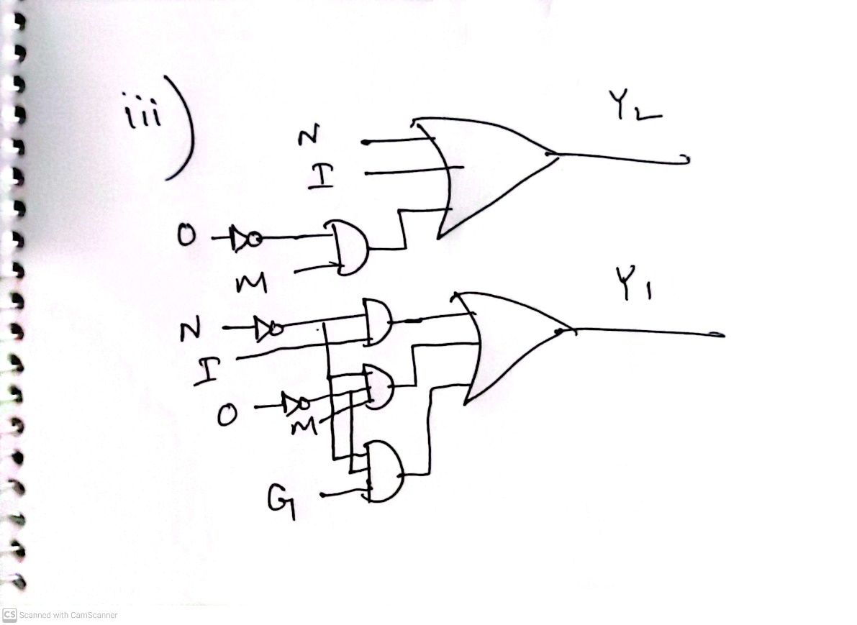
Spring 2024 Question 4

Slide 23
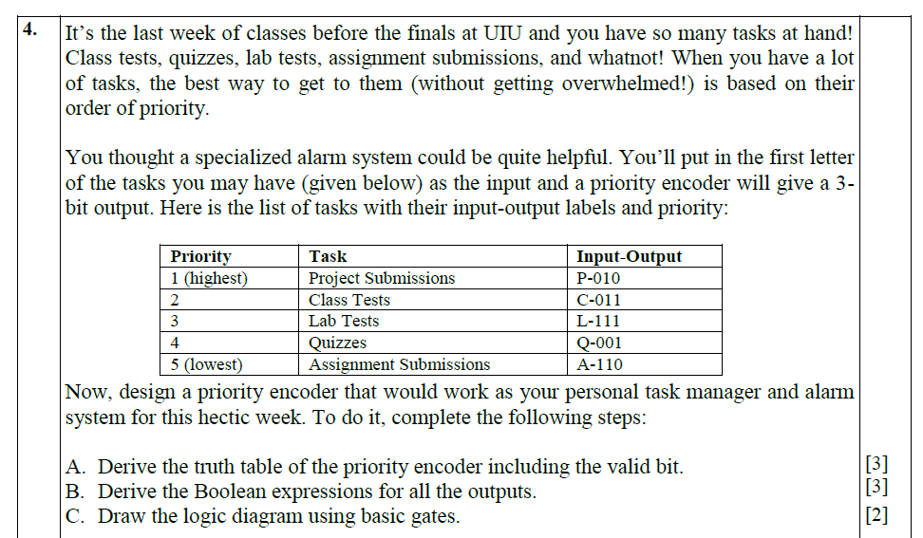
Fall 2023 Question 4

Slide 24
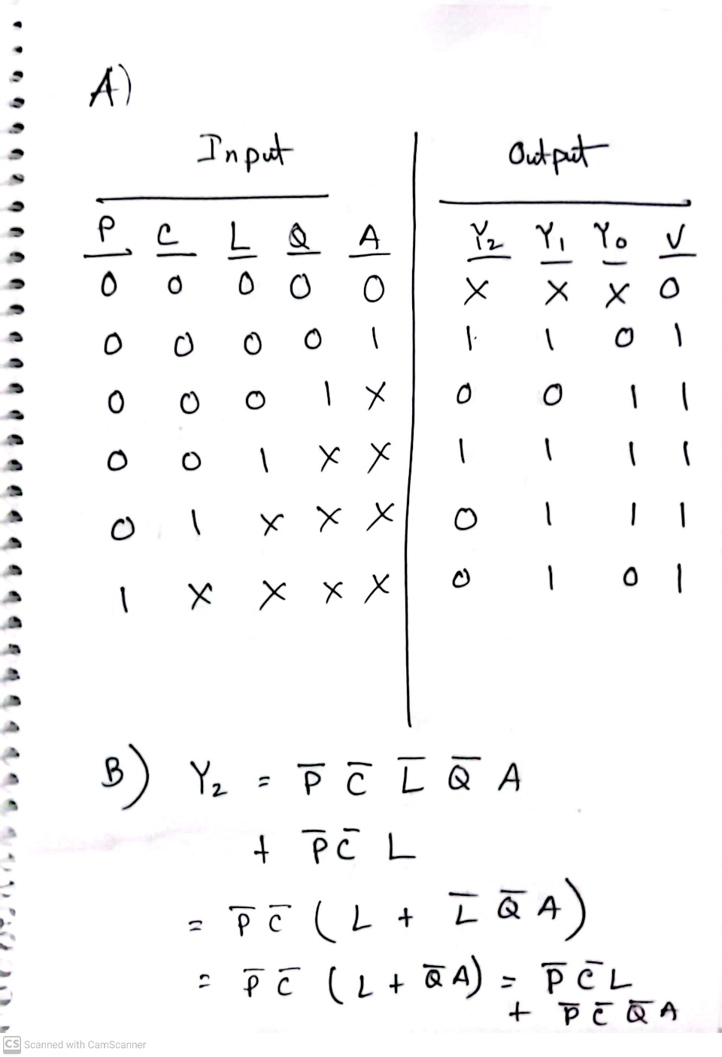
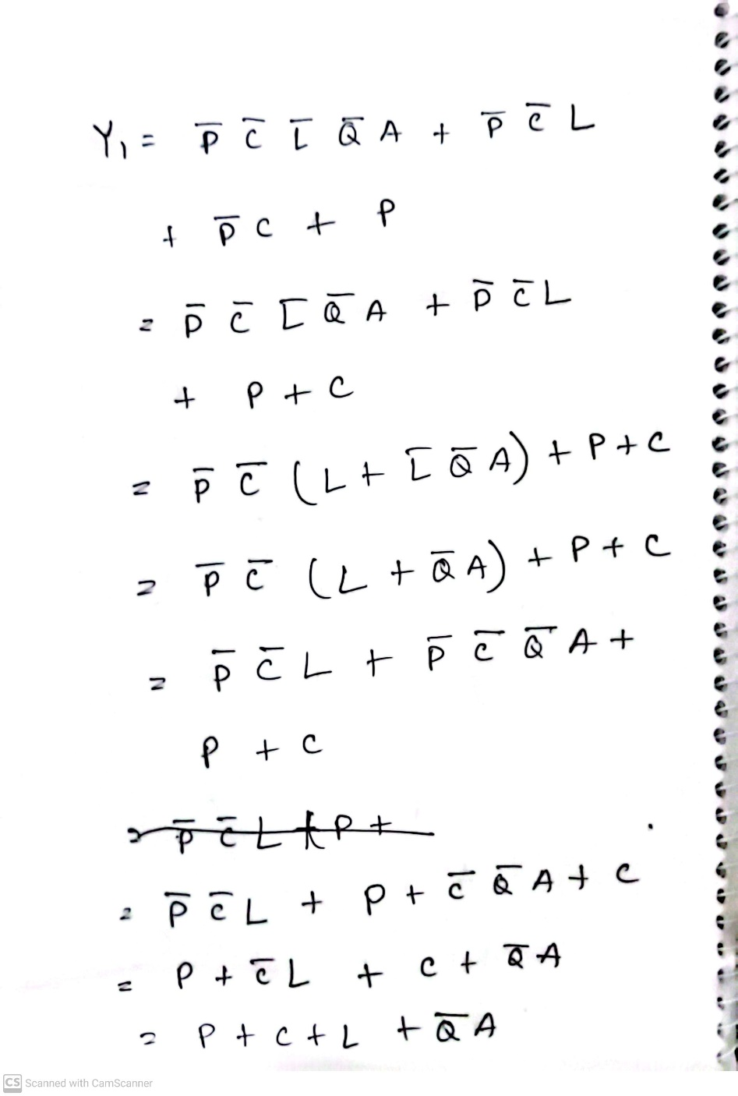
Fall 2023 Question 4

Slide 25
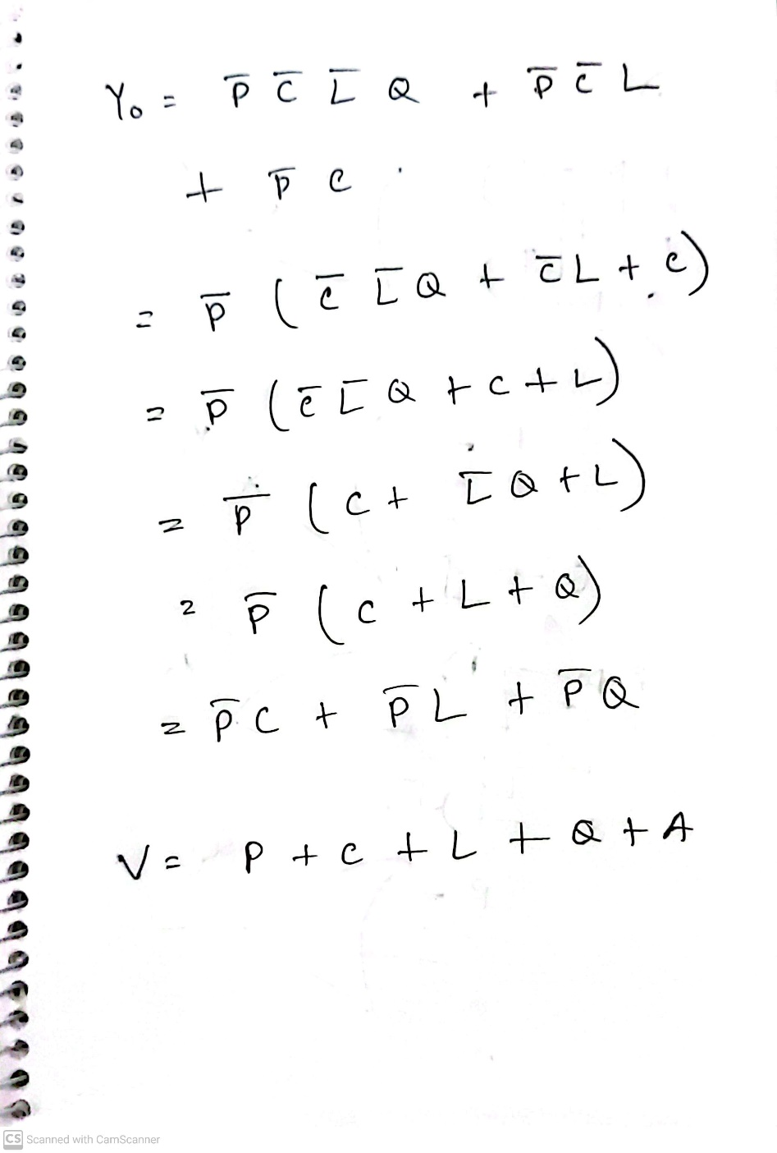
Fall 2023 Question 4

Slide 26
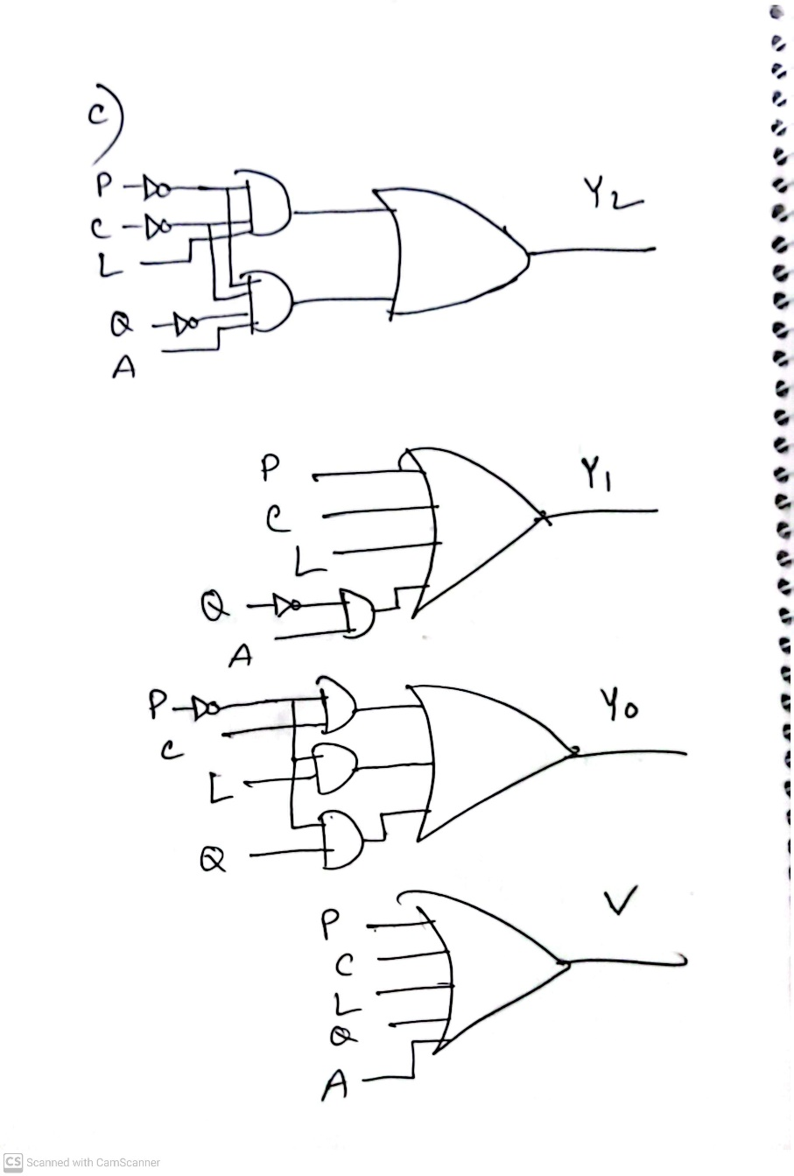
Fall 2023 Question 4

Slide 27
Selecting
Selecting of data or information is a critical function in digital systems and computers
Circuits that perform selecting have:
A set of information inputs from which the selection is made
A single output
A set of control lines for making the selection
Logic circuits that perform selecting are called multiplexers
Selecting can also be done by three-state logic or transmission gates

Slide 28
Multiplexers
A multiplexer selects information from an input line and directs the information to an output line
A typical multiplexer has n control inputs (S_{n − 1}, … S₀) called selection inputs, 2^{n} information inputs (I₂^{n} ₋ ₁, … I₀), and one output Y
A multiplexer can be designed to have m information inputs with m < 2^{n} as well as n selection inputs

Slide 29
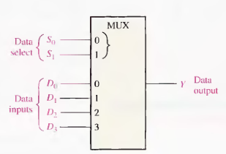
4-to-1-line Multiplexer

Slide 30
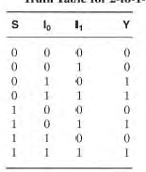
2-to-1-Line Multiplexer
Since 2 = 2¹, n = 1
Selection variable S:
S = 0 selects input I₀
S = 1 selects input I₁
The equation:
Y = I₀ + SI₁
The circuit:
S | Y
0 | I₀
1 | I₁
S

Slide 31
2-to-1-Line Multiplexer (continued)
Note the regions of the multiplexer circuit shown:
1-to-2-line Decoder
2 Enabling circuits
2-input OR gate
To obtain a basis for multiplexer expansion, we combine the Enabling circuits and OR gate into a 2 × 2 AND-OR circuit:
1-to-2-line decoder
2 × 2 AND-OR

Slide 32
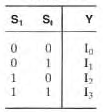
Example: 4-to-1-line Multiplexer
2-to-2²-line decoder
2² × 2 AND-OR
Y = (S₁ S₀) I₀ + (S₁ S₀) I₁ + (S₁ S₀) I₂ + (S₁ S₀) I₃

Slide 33
Combinational Function Implementation
Alternative implementation techniques:
Decoders and OR gates
Multiplexers (and inverter)

Slide 34
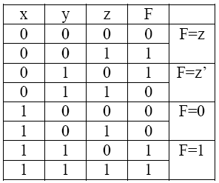
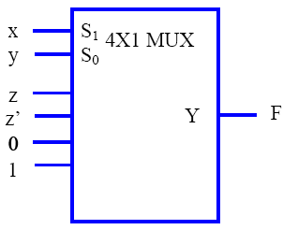
Combinational Function Implementation
F(x,y,z) = Σ(1,2,6,7) using 4-to-1 multiplexer.
Connect the variables x and y to the selection inputs S1, and S0. The inputs of the multiplexers can be obtained from the truth table as shown below.

Slide 35
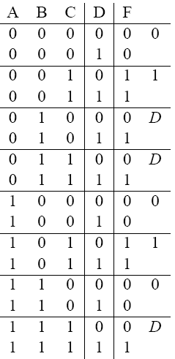
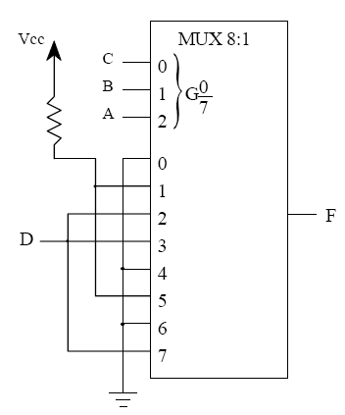
F(A, B, C, D) = Σ(2, 3, 5, 7, 10, 11, 15)

Slide 36
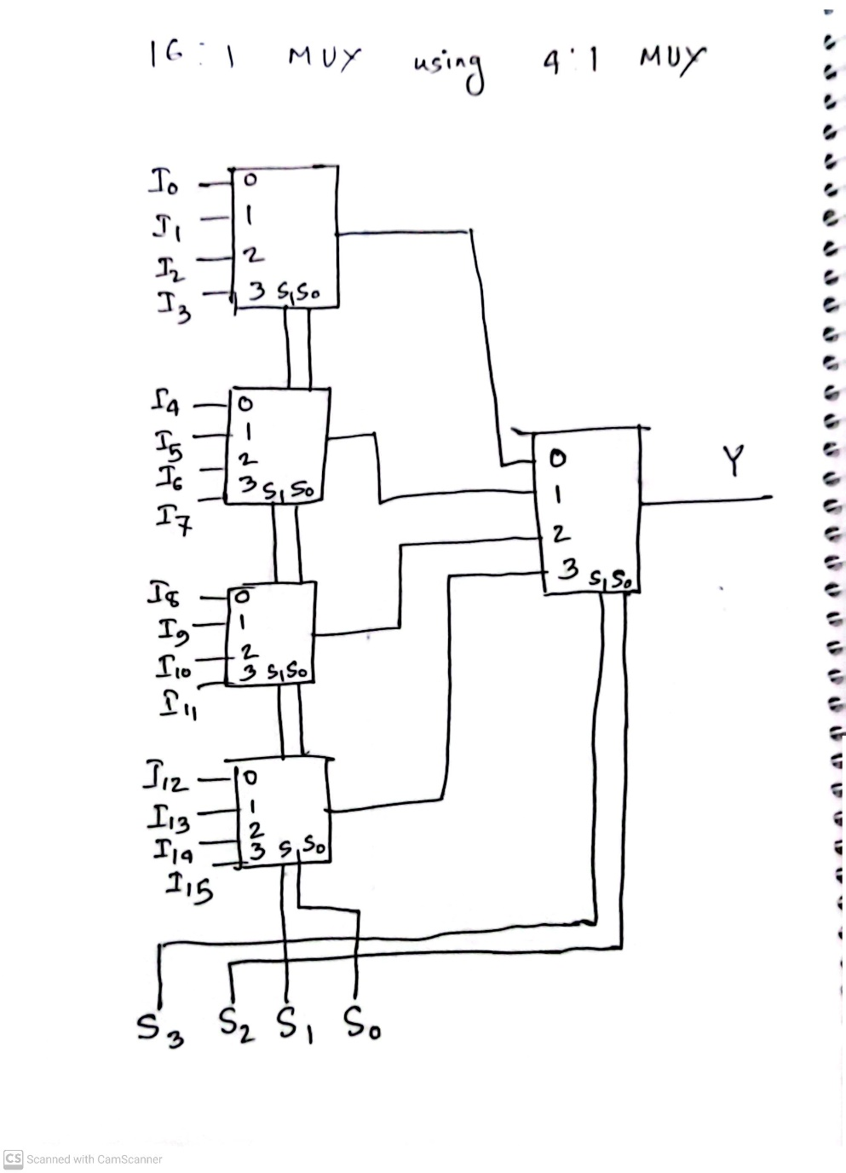
Spring 2024 Question 7

Slide 37
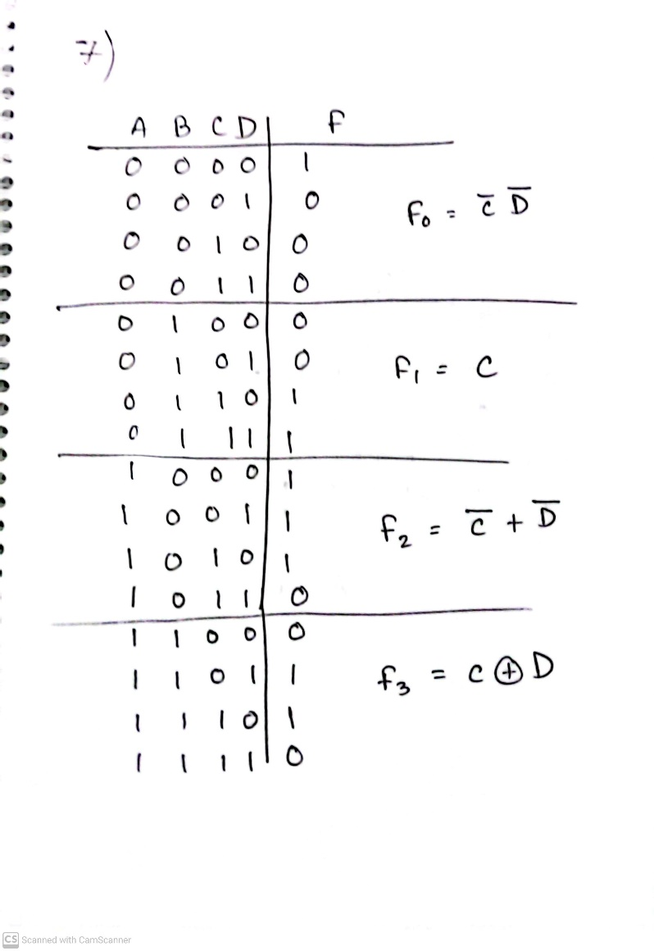
Fall 2023 Question 7

Slide 38

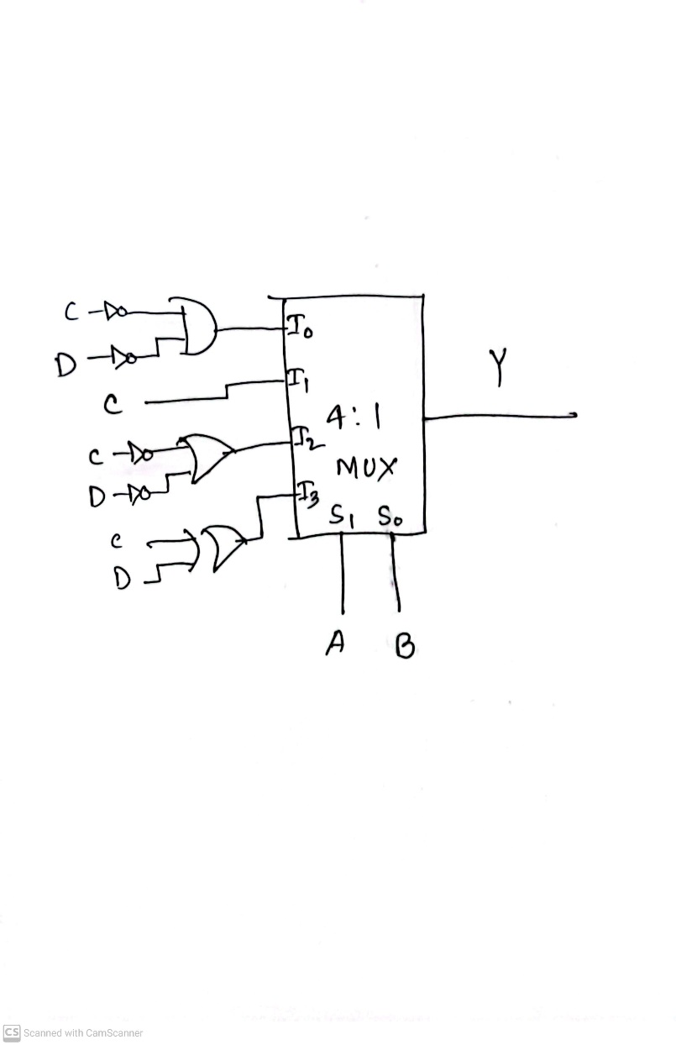
Fall 2023 Question 7

Slide 39
Thank You

